Slide 1
COLOR

Slide 3
How do we see colors?

Slide 5
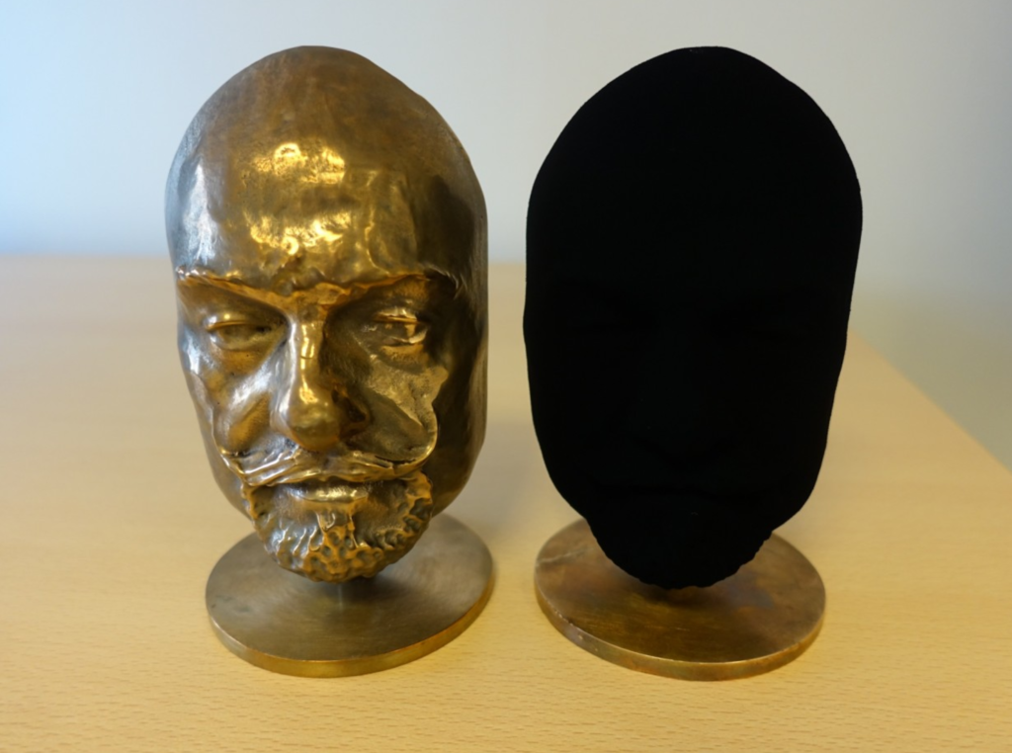

Slide 6
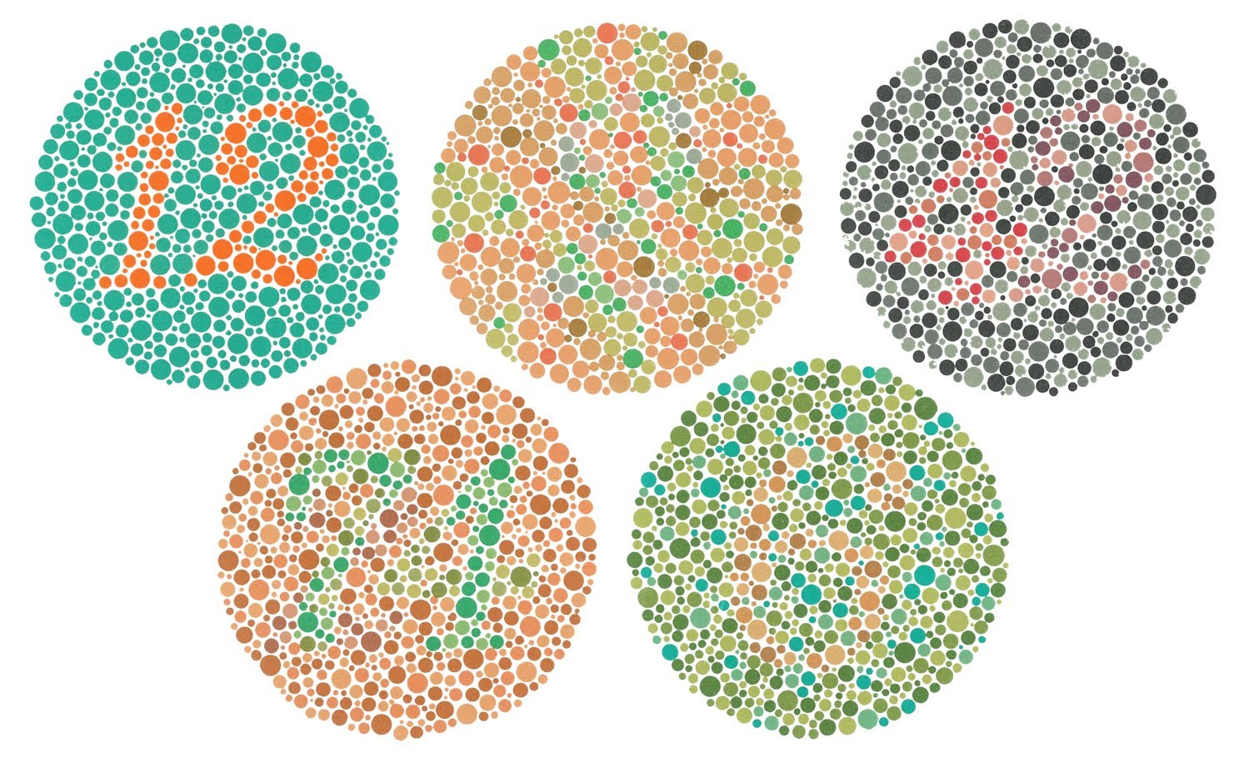

Slide 10
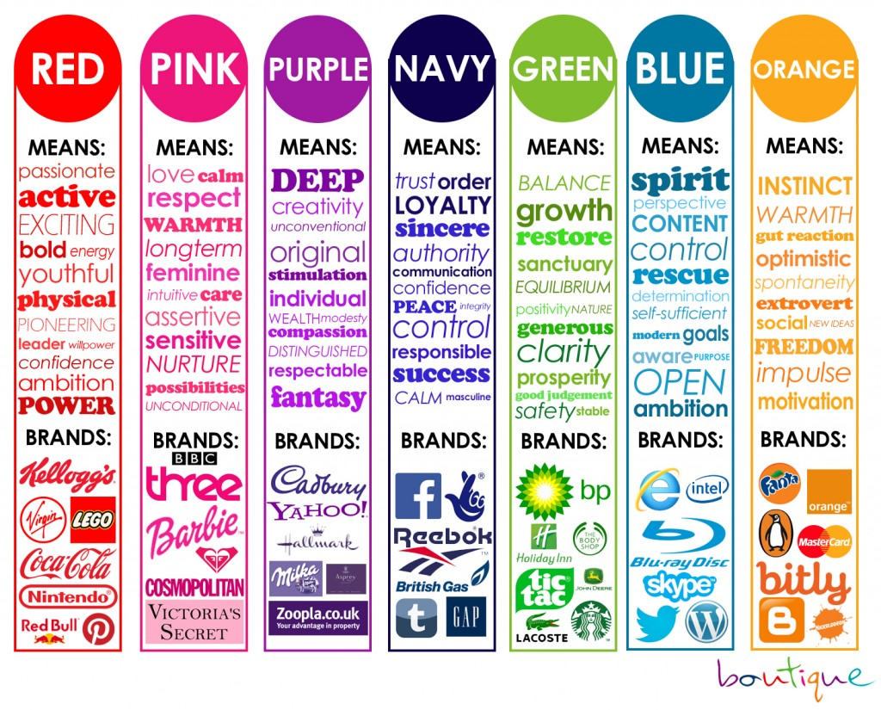

Slide 11
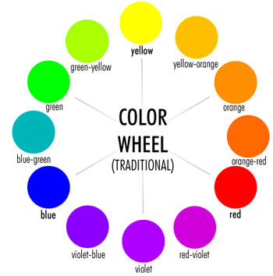

Slide 12
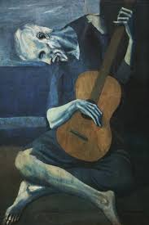
Monochromatic Color Scheme

Slide 13
Achromatic Color Scheme

Slide 14
Primary Color Scheme

Slide 16
Secondary Color Scheme

Slide 17
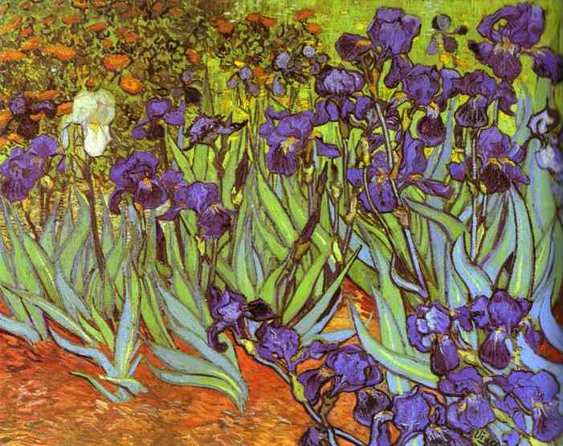

Slide 18
Intermediate Color Scheme

Slide 19
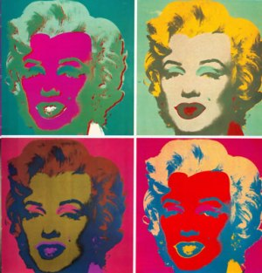

Slide 20
Complementary Color Scheme

Slide 21
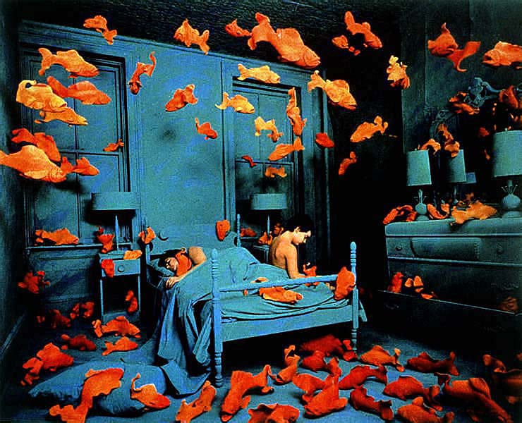

Slide 22
Split Complementary

Slide 24
Triadic Color Scheme

Slide 26
Tetradic Color Scheme

Slide 27
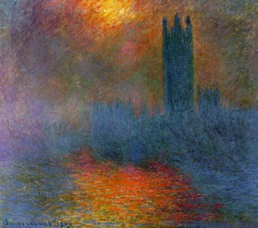

Slide 28
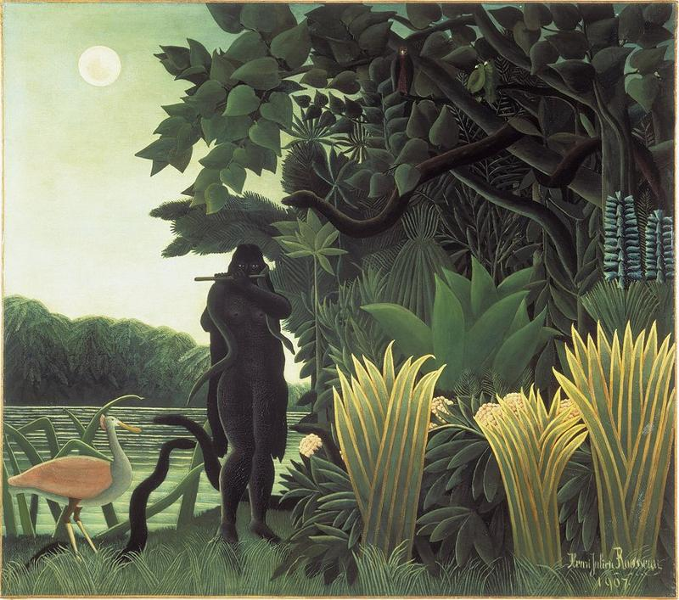
Analogous Color Scheme

Slide 29
Cool Colors

Slide 30
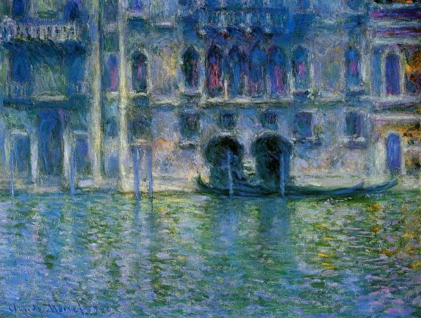

Slide 31
Warm Colors

Slide 32
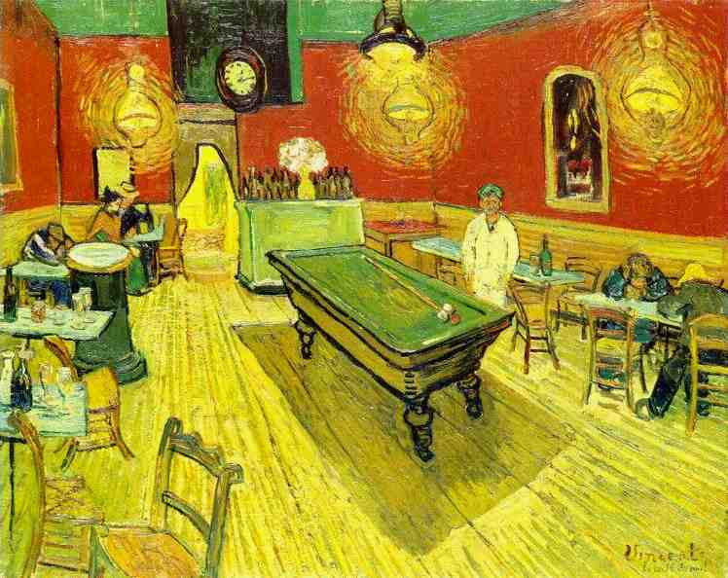

Slide 33
TEST

Slide 34
