Slide 1
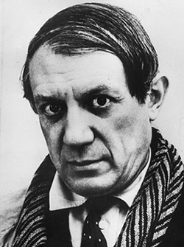
Pablo Picasso
“Every child is an artist. The problem is how to remain an artist once we grow up”
The Prodigy
1881 - 1973

Slide 3
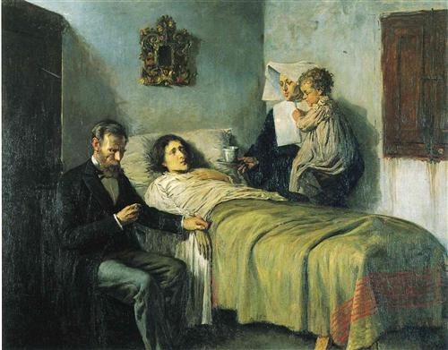

Slide 4
The Early Years Pablo Diego Jose Francisco De Paula Juan Nepomuceno Maria de los Remedios Cipriano de la Santisima Trinidad Ruiz Picasso
Born in Malaga, Spain
Was thought to be a Stillborn
His first words were Piz Piz for Lapiz
Could draw before he could talk
Started receiving serious art training at the age of 7 from his father

Slide 5
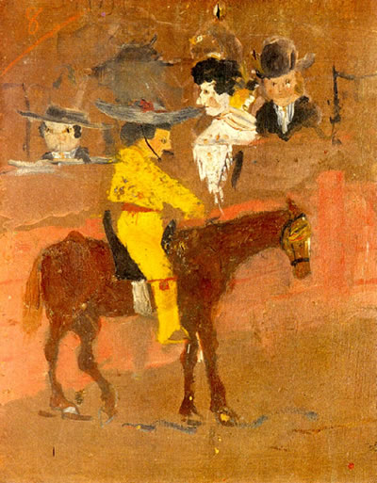

Slide 6
Picasso’s family moved from Malaga to La Coruna for his father’s teaching career
One evening Don Jose (picasso’s dad) found Picasso painting one of his unfinished sketches.
The painting was so well done that Don Jose gave Picasso (13 years old) his palette and brushes and vowed never to paint again

Slide 7
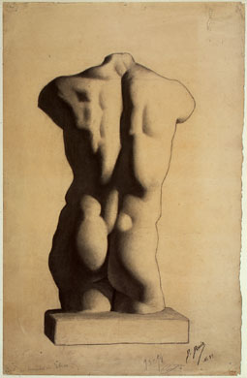

Slide 8
Independence
Picasso moved away from home and went to school in Madrid
Soon after enrolling Picasso stopped attending classes
Picasso was soon cut off from any funds from his Uncle

Slide 9
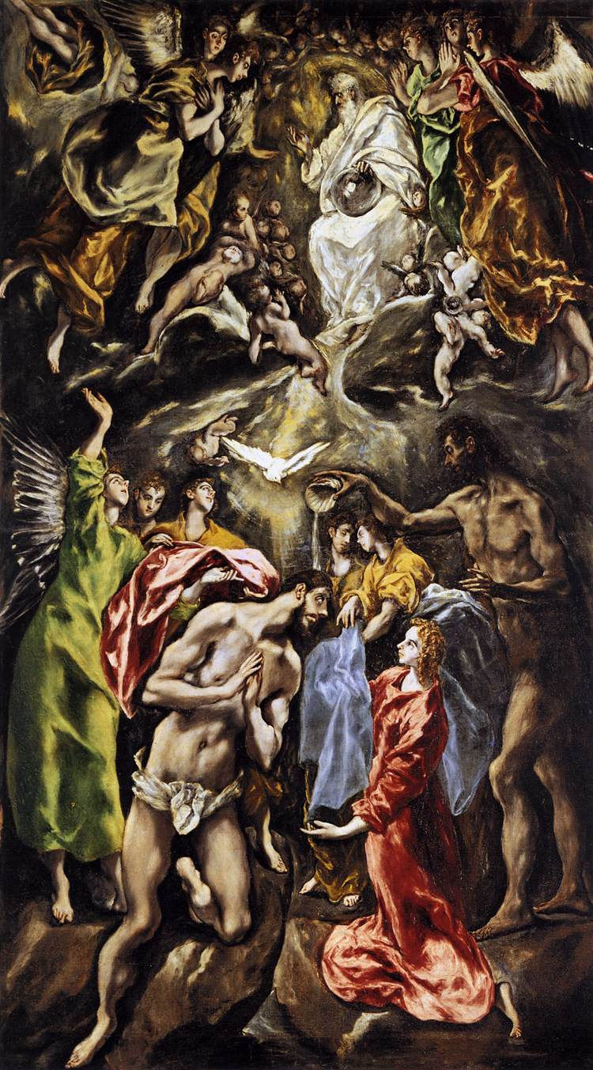
Inspiration (a step away from realism)
El Greco
Valasquez Goya
Zurbaran

Slide 10
The Blue Period
Started in 1901
Paintings were based off of the suicide of a friend
Themes grew very dark and sad.

Slide 11
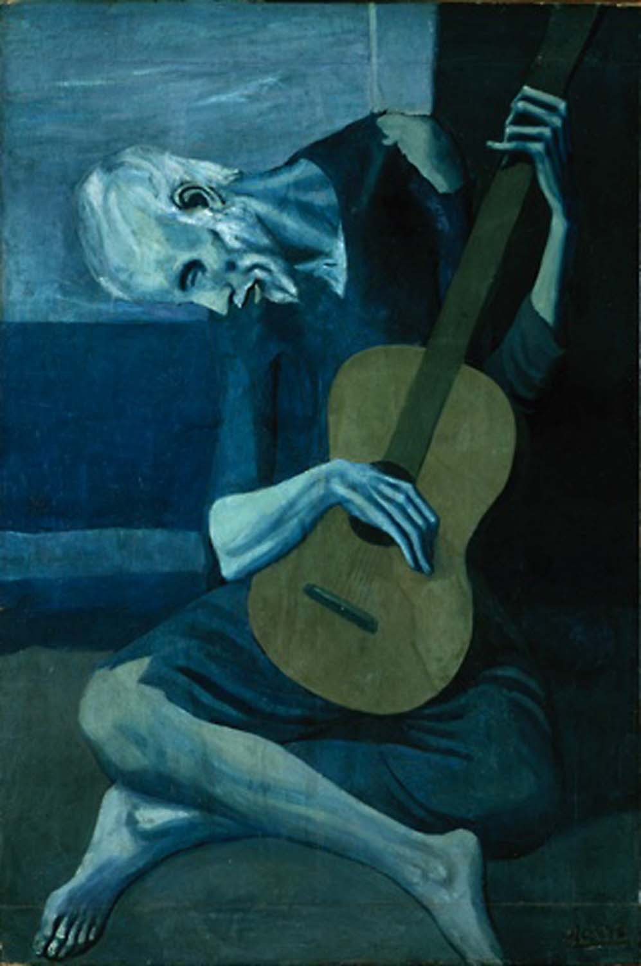

Slide 12
The Saltimbanque (rose period)
Started in 1905
Dropped the blue palette
Started painting images of circus life
Used red chalky type palette

Slide 13
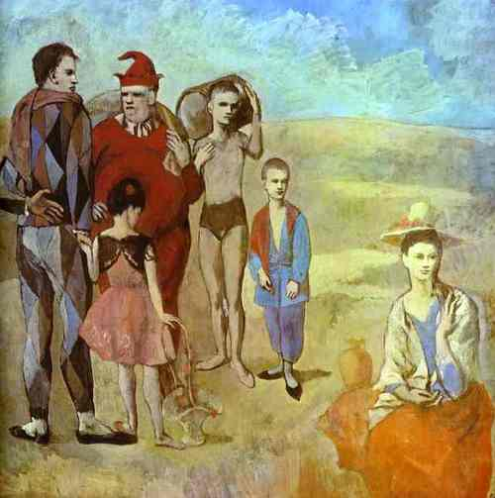

Slide 14
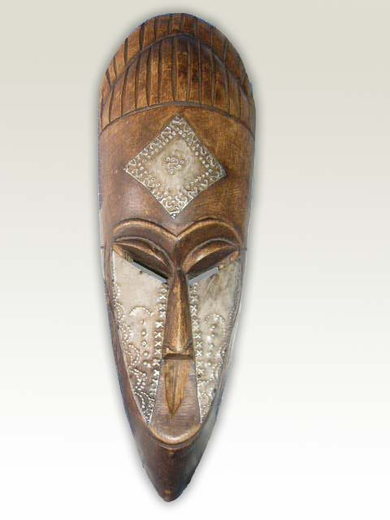
African Influenced Period
Picasso started collecting African masks
These masks started to influence Picasso into making faces more angular and rigid

Slide 15
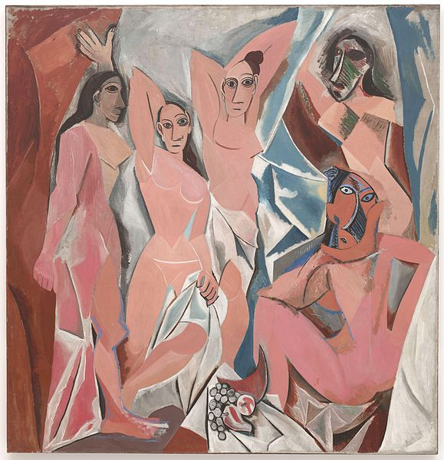

Slide 16
Analytical Cubism
Started in 1909
Monochromatic painting
Started with George Braque
Analyze objects into shapes and flat planes

Slide 17
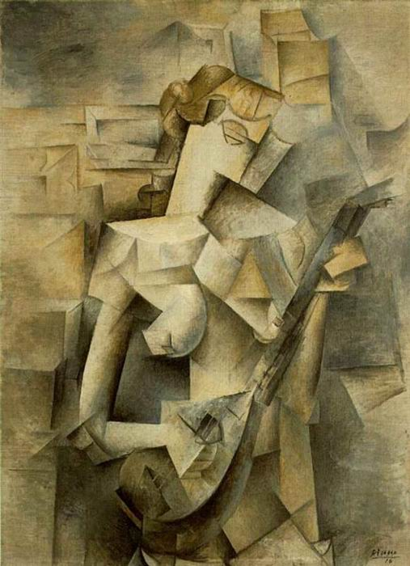

Slide 18
Synthetic Cubism
Started in 1912
Wider variety in Palette
Incorporated collage into fine art

Slide 19
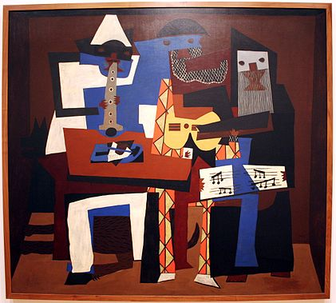

Slide 20
Later works
Classicism and surrealism
He often changed styles again from one genre to another
Started doing more sculptures

Slide 21
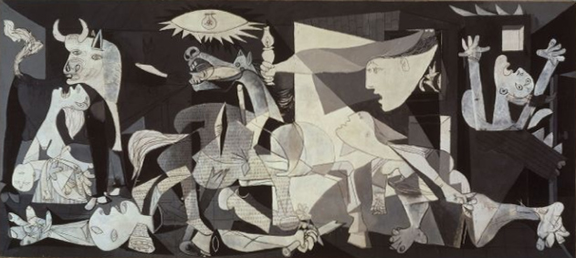

Slide 22
While looking back at some French children’s artwork Picasso exclaimed that at their age he was drawing like Raphael, but it would take many years to learn how to draw like a child.

